Slide 1
Session 1

Slide 2
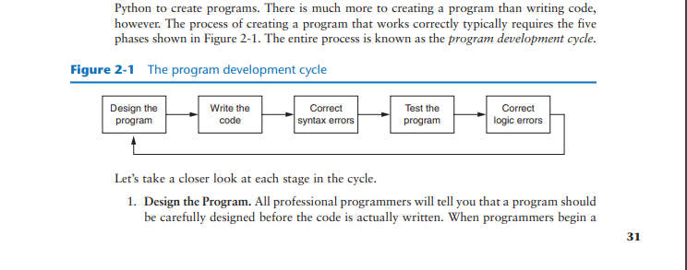
Program Development cycle
CONCEPT: Programs must be carefully designed before they are written. During the design process, programmers use tools such as pseudocode and flowcharts to create models of programs.

Slide 3
Pseudocode
Input the hours worked
Input the hourly pay rate
Calculate gross pay as hours worked multiplied by pay rate
Display the gross pay

Slide 4
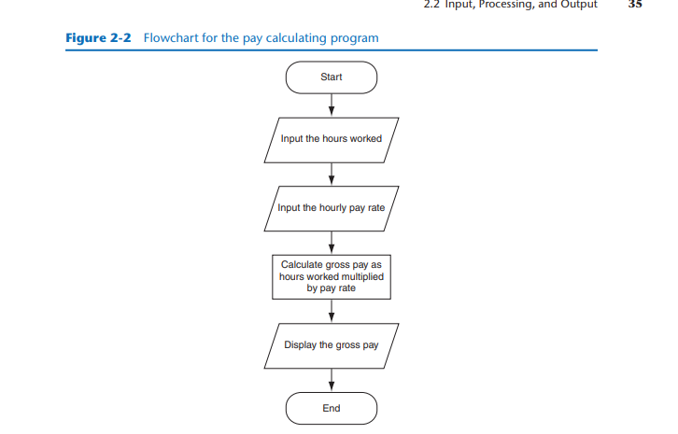
Flowcharts

Slide 5
Input, Processing, and Output
CONCEPT: Input is data that the program receives. When a program receives data, it usually processes it by performing some operation with it. The result of the operation is sent out of the program as output.
Computer programs typically perform the following three-step process:
1. Input is received.
2. Some process is performed on the input.
3. Output is produced.

Slide 6
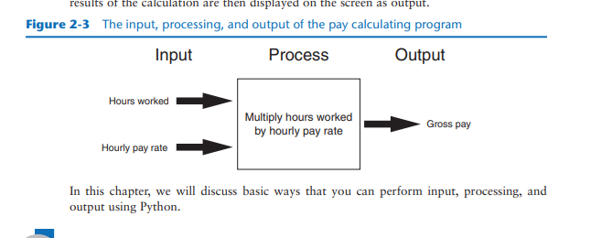

Slide 7
Comments
CONCEPT: Comments are notes of explanation that document lines or sections of a program. Comments are part of the program, but the Python interpreter ignores them. They are intended for people who may be reading the source code.

Slide 8
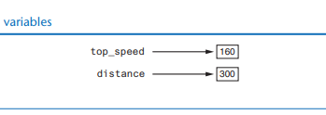
Variables
CONCEPT: A variable is a name that represents a storage location in the computer’s memory.

Slide 9
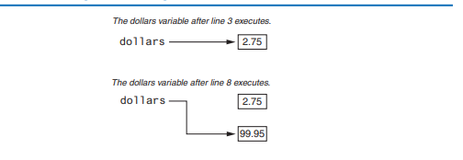
Variable Reassignment

Slide 10
Reading Input from the Keyboard
CONCEPT: Programs commonly need to read input typed by the user on the keyboard. We will use the Python functions to do this.

Slide 11
Performing Calculations
CONCEPT: Python has numerous operators that can be used to perform mathematical calculations.

Slide 12
String Concatenation
CONCEPT: String concatenation is the appending of one string to the end of another.

Slide 13
Displaying Formatted Output with F-strings
CONCEPT: F-strings are a special type of string literal that allow you to format values in a variety of ways.

Slide 14
Named Constants
CONCEPT: A named constant is a name that represents a special value, such as a magic number.

Slide 15
Introduction to Turtle Graphics
If we have time 🙂, or go over labs or homework, or maybe answer questions.

